Slide 1
Financial Literacy for Mature Over 55

Slide 2
This presentation was a created by a volunteer Task Force of The Georgia Society of Certified Public Accountants (GSCPA).
Special thanks The Georgia Consortium of Financial Literacy and Georgia Consortium Executive Director Nancy Swartzmiller.
2018-2019 GSCPA Financial Literacy Task Force
Beza Asrat
Art Auerbach
Cromwell Baun
Walt Bryde
Nadine Creutz-Adams
Julian Davis
Denise Grove
Teresa Kelly
Michael Lopata
Michael McBride
Bryce Nations
Kevin Teasley
The sites listed through out the presentation are from 3rd parties and not The Georgia Society of CPAs. All views or opinions expressed on these sites do not necessarily represent the views or opinions of GSCPA. Please use this information at your own risk. The primary purpose of this presentation and materials is to educate and inform. This presentation and materials do not constitute professional advise or services.

Slide 3
Medicare New Cards
Don’t throw away the new card.
Go to www.medicare.gov/newcard
If you have not received your new Medicare card, please use the above link to check the status of arrival.
The new card will have a 11 digit id number to replace your social security number on the old card.
Notes:
When you turn 65, you qualify for Medicare and may apply at that point.

Slide 4
If you get a call from someone claiming to be from the IRS….
Stay calm.
In general, the IRS will correspond first in writing.
Do NOT give any information over the phone.
If possible, use your caller ID to note the phone number.
Go to phishing@irs.gov to report the suspected fake caller. Please give them the number. IRS will try to get in touch with them.

Slide 5
If someone comes to your door claiming to be from the IRS, Department of Revenue, or Utility Services…..
If you are not expecting services or visitors of any kind, do NOT let him or her into your home.
Do NOT give them any information.
If someone is claiming they are from the IRS, they must have 2 pieces of identification. Each IRS employee carries a name badge and a federal employment card with their picture. The IRS will make an appointment 2 weeks prior to the appointment date.
Call 911.
This Photo by Unknown Author is licensed under CC BY-SA
Notes:
Please note to the audience – please keep your cell phone in your hand when answering the door. Keep 911 programed in your favorites of your phone for quick and easy access.

Slide 6
GPS
Do not set your GPS to your actual home address.
If possible, set it to the nearest police or fire station.
Notes:
GPS might be located on your phone, in your car, or on a portable GPS device.
Setting your address to the nearest police or fire station will help if your car or phone is stolen.
Keep your phone locked with a security code at all times.

Slide 7
Telemarketers
Most effective – if you do not know the number, do not answer.
National Do Not Call Registry
https://www.donotcall.gov/
Spoofing
According to AARP, spoofing can be defined as “scammers and telemarketers using Voice over Internet Protocol (VoIP) software to mimic your area code and three-number prefix to make it appear as if an incoming call is originating from near your own location.” https://www.aarp.org/money/scams-fraud/info-2017/scammers-neighbor-robocalls-spoofing-fd.html
Phone Number Storage
Always save Emergency Services in your phone for a quick, easy dial in an emergency.
Set up your ICE (In Case of Emergency) Contacts in your phone.
Notes:
ICE – could be your next of kin or someone who knows your healthcare directives and any healthcare issues

Slide 8
Robo Calls
There are many services that assist with stopping robo calls.
Free for VOIP landlines (there is a fee for cell phones)
For most, the service stops anywhere from 1 to 4 calls per day
The way it works is - the phone will ring once; if the call is from one of the call centers that nomorobo has ID'ed as a telemarketer, the phone does not ring a second time. So before answering the phone, make sure it rings at least 2 times
Notes:
Please note to the audience the nomorobo is an example of this service. There are many companies available. This is an example and not a promotion of use.
Here is an article to discuss these different services: https://www.pcmag.com/feature/362120/how-to-block-robocalls-and-spam-calls/18

Slide 9
US Mail
Opt. Out
Direct Marketing Association
www.dmachoice.org
Fill out a form online to decrease unsolicited mailings.
There is a small, one-time fee for the service.
Credit Card Offers
Check your mail box often.
Shred all unused offers.
www.optoutprescreen.com or call 888-567-8688 (888-5-OPT-OUT)
Do not put outgoing mail with confidential information in your home or office mailbox with the flag up. Please take these directly to a post office or USPS drop box.
Notes:
DMA Choice – add wording here from the website.

Slide 10
Email and Online Ordering
Unsubscribe to any unwanted emails and catalogs.
When ordering online, do not check the box on the store website for promotional materials which should cut down on the amount of junk emails received.
Do not use your credit card or debit card on an untrusted site.
This Photo by Unknown Author is licensed under CC BY
Notes:
Credit cards seem to easier for online returns and may offer a higher degree of protection.
How do know if a website is secure?
Check the SSL Certificate. Look at the URL of the website. If it begins with “https” instead of “http” it means the site is secured using an SSL Certificate (the s stands for secure). SSL Certificates secure all of your data as it is passed from your browser to the website's server.Nov 26, 2014
How to Know if a Website is Secure | DigiCert Blog
https://www.digicert.com/blog/buy-site-know-website-secure/
https://www.thoughtco.com/gauging-website-reliability-2073838
https://www.digicert.com/blog/buy-site-know-website-secure/

Slide 11
Financial Advisors and a Trusted Party
Ask a trusted party to assist you with your financial matters before you need help. Make sure this trusted party knows your passwords.
Have someone you TRUST check your financial advisor’s credentials.
Have someone you TRUST make sure that all bills are paid, on time.
Especially important if you are under care for an extended period.
Notes:
You will need to get your score and report at different places.
Help may be any reason you cannot do it yourself – vacation, hospital stay, etc.

Slide 12
Financial Advisors and a Trusted Party, continued
Have someone you TRUST obtain your free credit report at least once a year.
This will help disclose any unauthorized accounts or credit cards opened in your name.
There are 3 major credit services. Georgia allows for 2 free reports per year.
Arrange for someone you TRUST to have limited account oversight.
You and someone you trust should monitor all accounts.
If you do not need to apply for new credit, consider a credit freeze.
Article on freezing your credit: https://www.creditkarma.com/id-theft/i/lock-freeze-credit-file/
Notes:
You and/or your trusted will need to get your score and report at different places.
Note that you can temporarily unfreeze your credit as needed. Add from article.

Slide 13
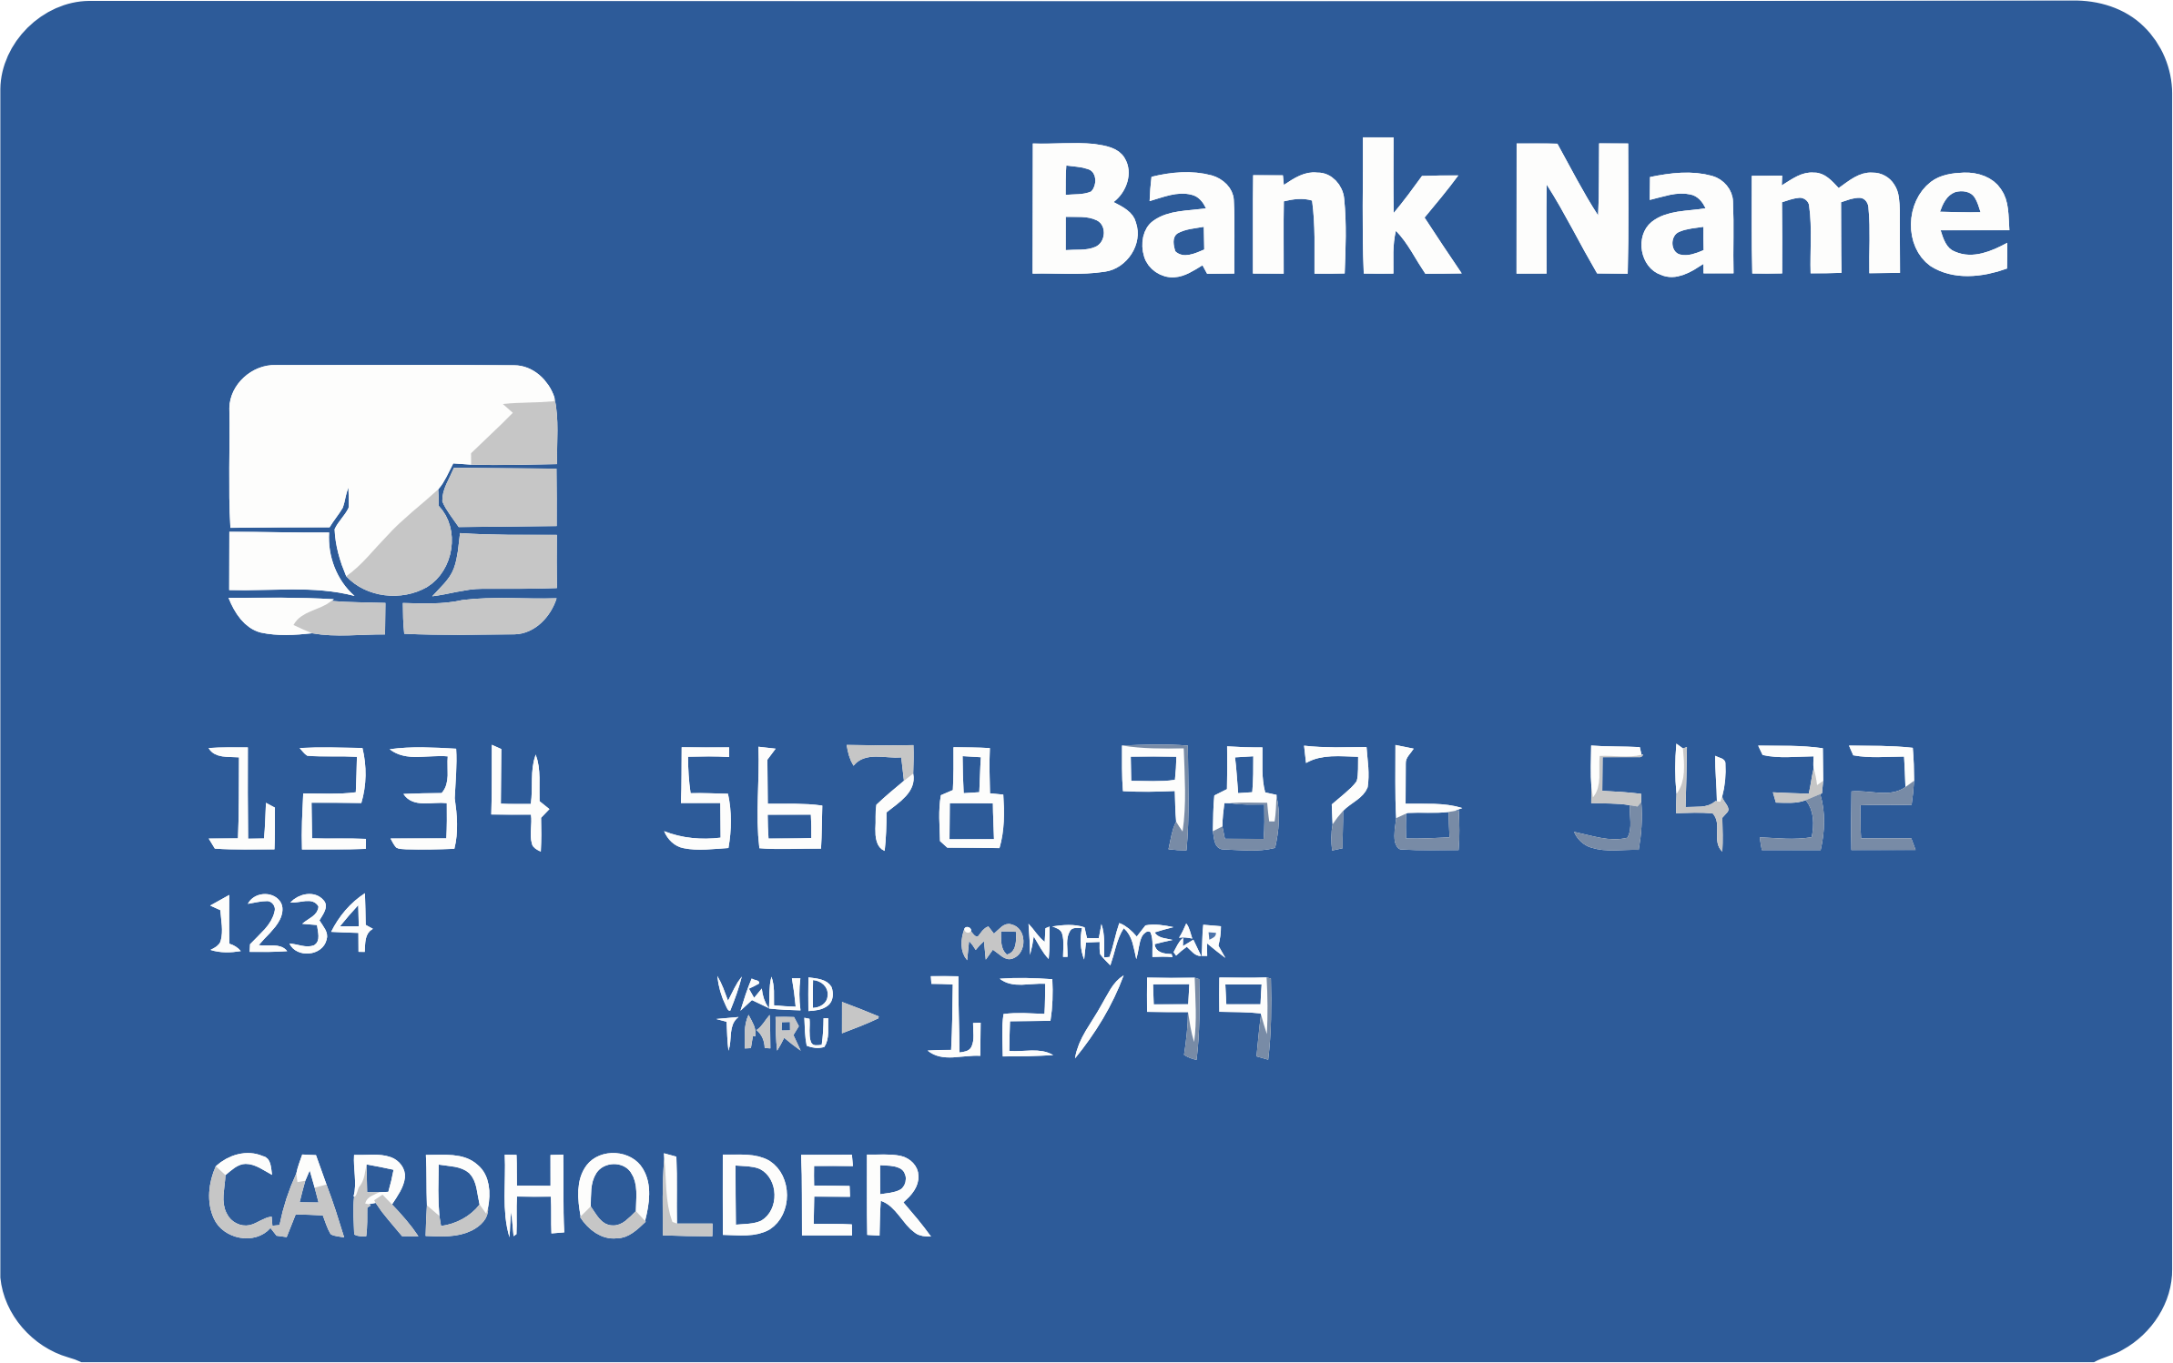
Credit Cards
Whenever possible, use a credit card over debit cards or cash.
Credit Cards have more protection against fraudulent charges.
Sign the back of your cards. If you choose not to sign your cards, add “ask for photo id”.
NEVER give your credit card information to unsolicited calls.
Notes:
https://blog.credit.com/2016/01/how-to-stop-credit-card-solicitations-for-good-133725/

Slide 14
Emergency Financial Management Plan
Power of Attorney
This should be someone you TRUST.
Does not have to be a relative.
Your Power of Attorney and someone you TRUST should make sure your bills are paid if you are sick and monitor your accounts for potential fraudulent charges.
This Photo by Unknown Author is licensed under CC BY-NC
Notes:
A general power of attorney does not give someone the right to sign a tax return or represent you in tax issues. This must be added.

Slide 15
Emergency Financial Management Plan, continued
Important Tip about Power of Attorney
Keep a valid copy of the power of attorney document (notarized) handy at all times.
If you travel, carry a certified copy of your Power of Attorney.
Routinely verify that your Power of Attorney is still capable.
Introduce your Power of Attorney to your banker, broker, lawyer, CPA, and any other professional that deals with your financial affairs and estate plans.
Notes:
A general power of attorney does not give someone the right to sign a tax return or represent you in tax issues. This must be added.

Slide 16
Helpful Sites
Internal Revenue Service
www.irs.gov
Georgia Consumer Protection Laws and Georgia Consumer Complaints
www.consumer@law.ga.gov
US Consumer Protection Agency
http://www.consumer.georgia.gov/
National Do Not Call registry
https://www.donotcall.gov/
Georgia Department of Law – Consumer Protection Division
http://www.consumer.georgia.gov/
Opt. Out of Credit Card Offers
call 888-567-8688 (888-5-OPT-OUT) or visit www.optoutprescreen.com
The sites listed above and through out the presentation are from 3rd parties and not The Georgia Society of CPAs. All views or opinions expressed on these sites do not necessarily represent the views or opinions of GSCPA. Please use this information at your own risk. The primary purpose of this presentation and materials is to educate and inform. This presentation and materials do not constitute professional advise or services.

